Slide 1
Concurrency Concepts Threads
Concurrent Programming CT074-3-2 Version 0120

Slide 2
Mock Exam
Moodle

Slide 3
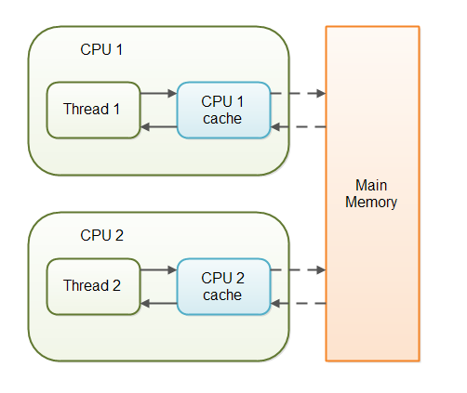
volatile

Slide 4
Topic & Structure of The Lesson
Round robin
Scheduler
Priority

Slide 5
Learning Outcomes
At the end of this topic, You should be able to
Describe the types of concurrency

Slide 6
Key Terms You Must Be Able To Use
If you have mastered this topic, you should be able to use the following terms correctly in your assignments and exams:
Round robin
Scheduler
Priority

Slide 7
Concurrency types
Round Robin
Scheduler
Priority

Slide 8
Round Robin
Round robin is the scheduling algorithm used by the CPU during execution of the process . Round robin is designed specifically for time sharing systems . It is similar to first come first serve scheduling algorithm but the preemption is the added functionality to switch between the processes .

Slide 9
Quantum
A small unit of time also known as time slice or quantum is set/defined . The ready queue works like circular queue.
All processes in this algorithm are kept in the circular queue also known as ready queue.

Slide 10
Each New process is added to the tail of the ready/circular queue . By using this algorithm , CPU makes sure, time slices ( any natural number ) are assigned to each process in equal portions and in circular order , dealing with all process without any priority .

Slide 11
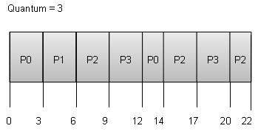

Slide 12
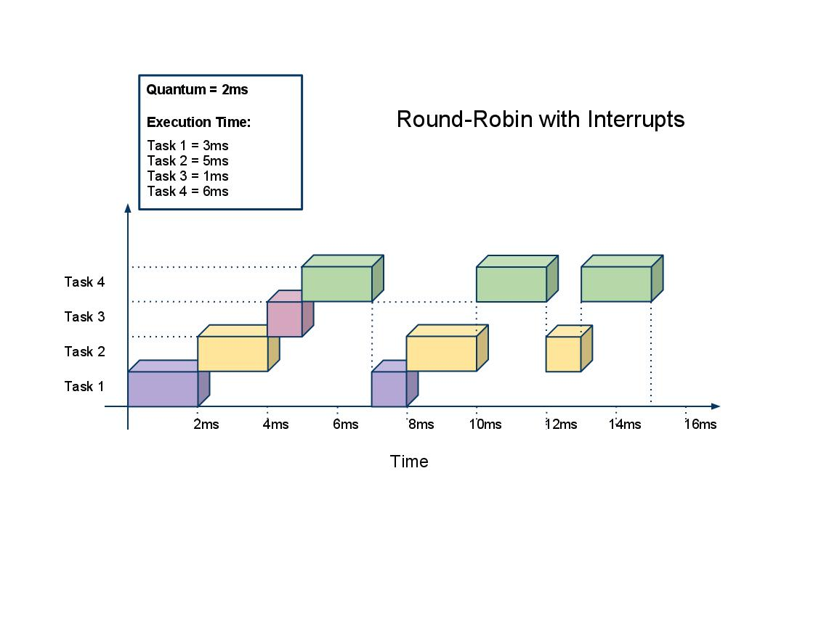

Round Robin

Slide 13
Round robin comes from the principle known as round robin in which every person takes equal share of something in turn .

Slide 14
First Come First Serve (FCFS) Scheduler
a.k.a. First-In-First-Out (FIFO)
Jobs are executed on first come, first serve basis.
Easy to understand and implement.
Poor in performance as average wait time is high.

Slide 15
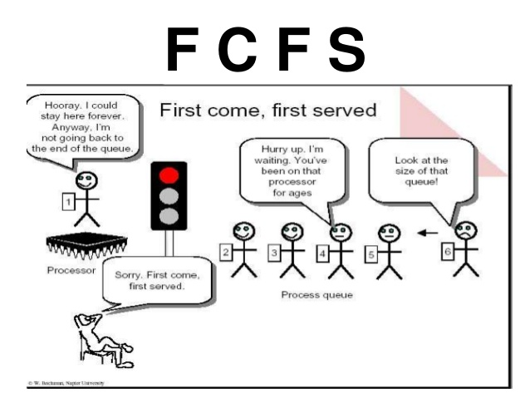

Slide 16
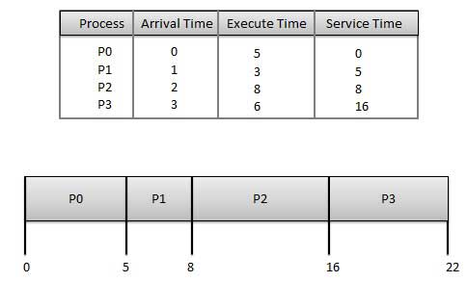
Wait time of each process:
Process | Wait Time : Service Time - Arrival Time
P0 | 0 - 0 = 0
P1 | 5 - 1 = 4
P2 | 8 - 2 = 6
P3 | 16 - 3 = 13
Average Wait Time: (0+4+6+13) / 4 = 5.55

Slide 17
LIFO
New processes placed ahead of queue
Improves response time for newly created processes
Problem?

Slide 18
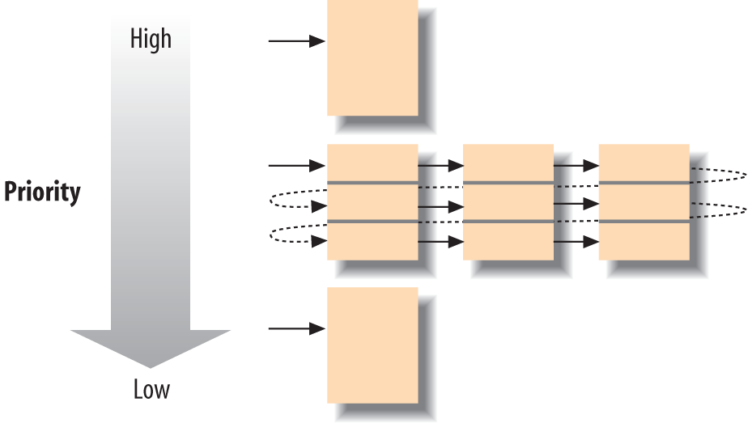
Priority

Slide 19
Question and Answer Session
Q & A

Slide 20
What we will cover next
Concurrency concepts 2

Slide 21
Topic & Structure of The Lesson
Creating threads in Java
Synchronisation
Asynchronicity

Slide 22
Learning Outcomes
At the end of this topic, You should be able to
Exlain the difference between processes and threads
Create a thread in Java

Slide 23
Key Terms You Must Be Able To Use
If you have mastered this topic, you should be able to use the following terms correctly in your assignments and exams:
Threads
Synchronisation
Asynchronicity

Slide 24
Processes vs Threads
A process is an executing instance of an application.
What does that mean?
For example, when you double-click the Microsoft Word icon, you start a process that runs MS Word.

Slide 25
Processes vs Threads
A thread is a path of execution within a process.
A process can contain multiple threads.
When you start MS Word, OS creates a process and begins executing the primary thread of that process.

Slide 26
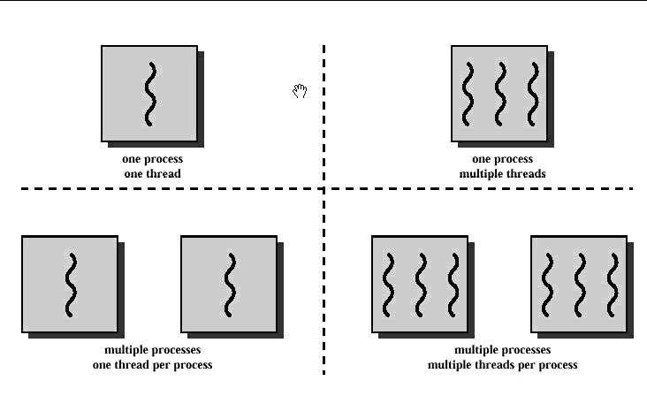
Processes vs Threads

Slide 27
Implementing processes - the OS view
A (heavyweight) process in an operating system is represented by its code, data and the state of the machine registers, given in a descriptor. In order to support multiple (lightweight) threads of control, it has multiple stacks, one for each thread.

Slide 28
Synchronisation
When we start two or more threads within a program, there may be a situation when multiple threads try to access the same resource and finally they can produce unforeseen result due to concurrency issue

Slide 29
Synchronisation
For example, if multiple threads try to write within a same file then they may corrupt the data because one of the threads can overwrite data or while one thread is opening the same file at the same time another thread might be closing the same file.

Slide 30
Monitors
So, there is a need to synchronize the action of multiple threads and make sure that only one thread can access the resource at a given point in time. This is implemented using a concept called monitors.
Each object in Java is associated with a monitor, which a thread can lock or unlock. Only one thread at a time may hold a lock on a monitor.

Slide 31
Mutual exclusion
In computer science, mutual exclusion refers to the requirement of ensuring that no two concurrent processes are in their critical section at the same time; it is a basic requirement in concurrency control, to prevent race conditions.

Slide 32
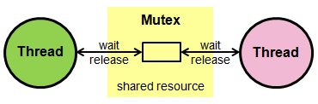
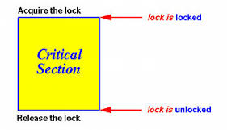

Slide 33
Asynchronicity
Asynchronous programming provides a non-blocking, event-driven programming model.
Leverages the multiple cores in system to provide parallelization by using multiple CPU cores to execute the tasks, thus increasing the application's throughput

Slide 34
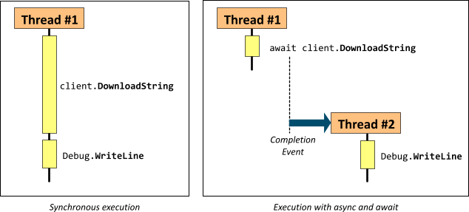

Slide 35
Asynchronicity
To implement asynchrony in Java, you would need to use Future or FutureTask, available in the java.util.concurrent package.
In using "Future" in your code, your asynchronous task will be executed immediately with the promise of the result being made available to the calling thread in the future.

Slide 36
Asynchronicity
import java.util.concurrent.Future;
public interface IDataManager {
// synchronous method
public String getDataSynchronously();
// asynchronous method
public Future<String> getDataAsynchronously();
}

Slide 37
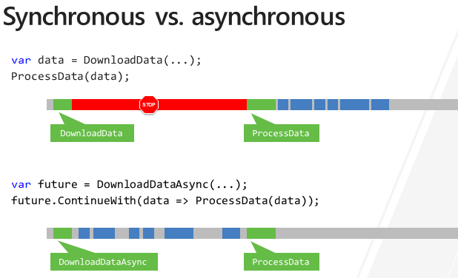

Slide 38
Question and Answer Session
Q & A

Slide 39
Assignment
Sample output

Slide 40
Programming exercise
Run ThreeCount3.java. Make it produce output as below:
Incrementing.....
i = 0
Incrementing.....
i = 1
Incrementing.....
i = 2
Decrementing.....
i = 3
Decrementing.....
i = 2
Decrementing.....
i = 1
Bye!

Slide 41
Exercise
Modify the Thread in week 2 to create 4 threads. Using thread priority, give thread 4 the highest priority. Adjust the program to make Thread 4 exit first.
Week 2 – RunnableThread OR ThreadExtend

Slide 42
volatile

Slide 43
Assignment Brief

Slide 44
What we will cover next
Shared objects and mutual exclusion

